Slide 1
Windows Communication Foundation (WCF)
Distributed Computer Systems
CT024-3-3-DCOMS and Version VC1

Slide 2
Topic & Structure of The Lesson
WCF
WCF design
WCF architecture
Service model namespace
Channels

Slide 3
Learning Outcomes
At the end of this topic, You should be able to
Describe about the WCF
Understand the WCF design principles
Important pieces of WCF
Draw the architecture of WCF

Slide 4
Key Terms You Must Be Able To Use
If you have mastered this topic, you should be able to use the following terms correctly in your assignments and exams:
WCF
Design principles
Service model
Architecture
Peer to peer

Slide 5
What is WCF?
Provides software services on machines, networks, and across the internet
Unified programming model for all of these
Supported natively on Windows Vista
Requires installation on XP
Not available on other platforms
Mono?
DotGnu?
Mac OSX ?

Slide 6
WCF Design Principles
Boundaries are explicit
No attempt to hide communication
Services are autonomous
Deployed, managed, and versioned independently
Services share contracts and schemas, not types
Contracts define behavior, schemas define data
Compatibility is policy-based
Policy supports separation of behavior from access constraints

Slide 7
Essential Pieces of WCF
Contracts for services, data, and messages
A contract is simply an interface declaration
Service, Data, and Message definitions
Class implementations
Configurations defined programmatically or declaratively
config files.
A host process (can be self hosted)
IIS, Windows Executable, Windows Service, or WAS
.Net Framework (3.5) Classes provide support for all of the above.

Slide 8
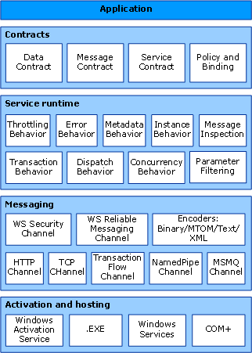
WCF Architecture

Slide 9
Service Model Namespace
Bindings, Channels, Endpoints, Messages, Serialization
Activation, Concurrency, Hosting, Security, Sessions
Queuing, Transactions
Exceptions

Slide 10
Channels
Channels are the vehicles that transport messages. They provide:
Transport protocols via bindings
Http, wsHttp, Tcp, MSMQ, named pipes
Encoding and Encryption
Reliable sessions
Communication modes
Simplex, duplex, send and wait
Security modes

Slide 11
Message Passing Communication
Messages are collection of data objects and their structures
Messages have a header containing system dependent control information and a message body that can be fixed or variable size.
When a process interacts with another, two requirements
have to be satisfied.
Synchronization and Communication.
Fixed Length
Easy to implement
Minimizes processing and storage overhead.
Variable Length
Requires dynamic memory allocation, so
fragmentation could occur.

Slide 12
Peer to Peer Communication
A peer-to-peer network is a distributed network architecture composed of participants that make a portion of their resources, such as processing power, disk storage or network bandwidth directly to network participants without the need for central coordination instances.
Used largely for sharing of content files such as audio, video, data or anything in a digital format.
There are many p2p protocols such as Ares, Bittorrent, or eDonkey.
Can be very large
Can also be used for business solutions for relatively small companies that may not have resources available to implement a server solution.

Slide 13

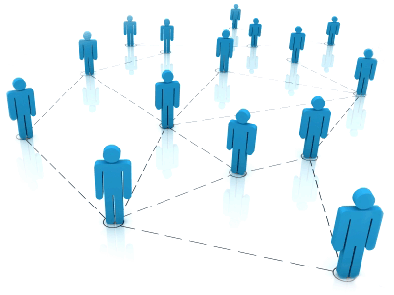
A Peer
Peers are both suppliers and consumers while in the traditional client-server model, the server supplies while the client only consumes.

Slide 14
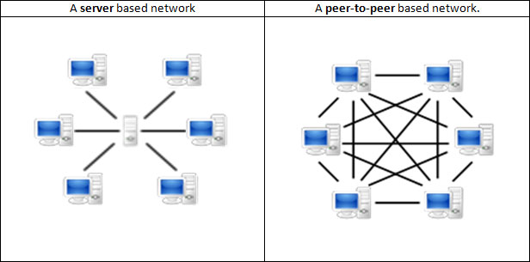
Peer-To-Peer VS Client-Server

Slide 15
Summary
Provides software services on machines, networks, and across the internet
Unified programming model for all of these
Service model namespaces are Bindings, Channels, Endpoints, Messages, Serialization
Channels are the vehicles that transport messages.

Slide 16
Question and answer session
Q & A

Slide 17
What we will cover next
ICE

